Slide 1
UNIT -I
Quine McClusky Minimization Technique

Slide 2
Content
Introduction
Boolean Equation Minimization Techniques – Quine-Mc-Clusky Method

Slide 3
Introduction
Digital logic circuit is collection of logic gates, input signals that drive them and output they produce.
These circuits can be expressed in truth table or equations. Both gives behavior of circuit. But, how to build is not specified.
While designing our main goal is to design efficient circuit.
Efficient circuit uses less number of gates, operate with high speed and with less power.
One way is to minimize the logic functions.

Slide 4
Minimization Techniques
Quine-McCluskey
Also called as method of prime implicants
The algorithm finds all possible groupings of 1’s through search, and then from that complete collection finds a minimal set that covers all min terms. Because this method searches for all possible solutions, and then selects the best, it can take a fair amount of computing time. It can take minutes to hours.
Similar to K-Map. But, represented in tabular form. Sometimes referred as tabulation method.
Why this method- K map can be used only upto 6 variables.
This method we can use for many variables.

Slide 5
Quine-McCluskey
Step 1: Find Prime implicants
Step 2: Draw Prime implicant table
Step 3: Find Essential prime implicant from table.

Slide 6
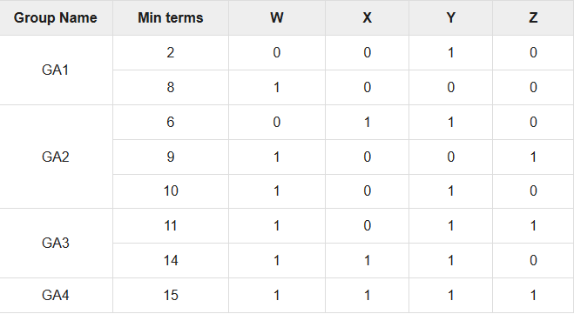
E.g. f(W,X,Y,Z)=∑m(2,6,8,9,10,11,14,15) Step 1: min terms with binary equivalent and group of min term with single 1, 2 one’s, 3 one’s & 4 one’s
Referred by www.tutorialspoint.com

Slide 7
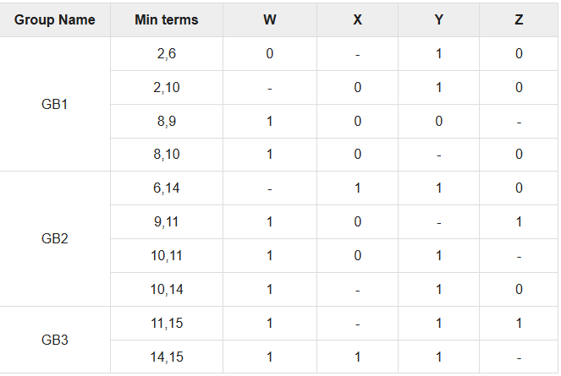
Quine-McCluskey
Step 2: Merging of min terms in group with single change in binary equivalent. Mark that change as –
Reference: Javatutorialpoint

Slide 8
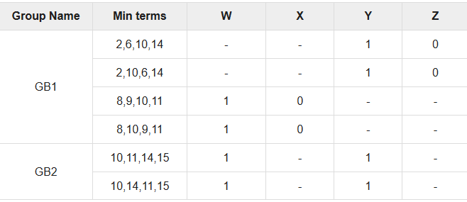
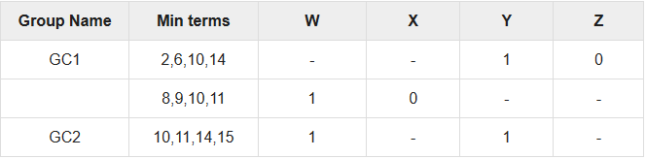
Quine-McCluskey
Step 3: Same as step 2 merging in 4
Step 4: Remove repeated rows

Slide 9
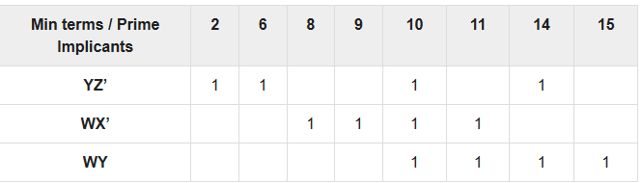
Quine-McCluskey
Step 5: No further reduction possible.
Prime implicant table
Step 6: Check min terms are prime implicants.
Prime implicants who covers min terms are essential prime implicants.
YZ’ covers 2,6
WX’ covers 8,9
WY covers 15
All 3 are Essential prime implicants
Simplified Equation: f(W,X,Y,Z) = YZ’ + WX’ + WY

Slide 10
Essential Prime Implicants – These are those sub cubes (groups) which cover atleast one minterm
that can’t be covered by any other prime implicant.
Essential prime implicants(EPI) are those prime implicants which always appear in final solution.
Example:

Slide 11

Solve this example with Quine-McCluskey
Answer is
f(W,X,Y,Z)=∑m(4,5,6,8,10,13)

